Slide 1
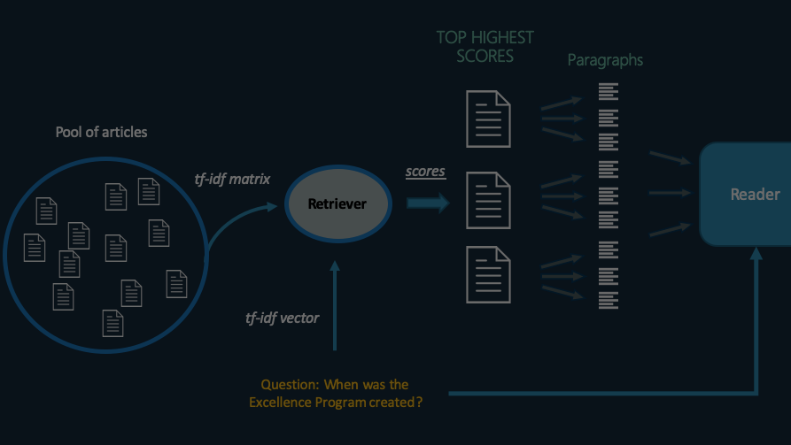


Slide 2
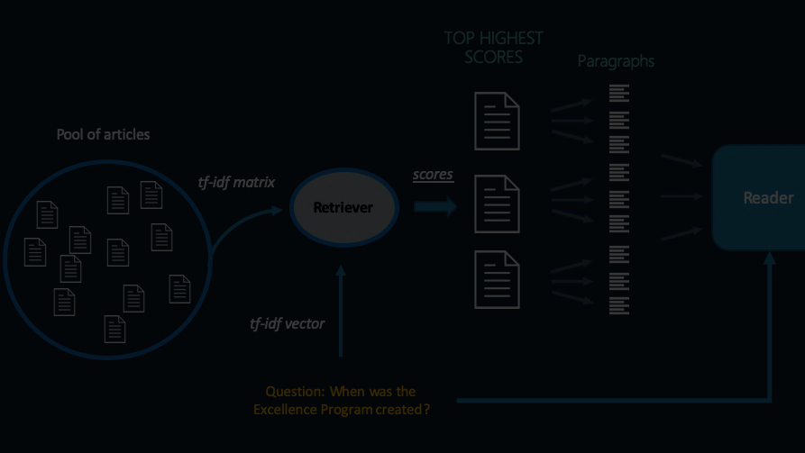



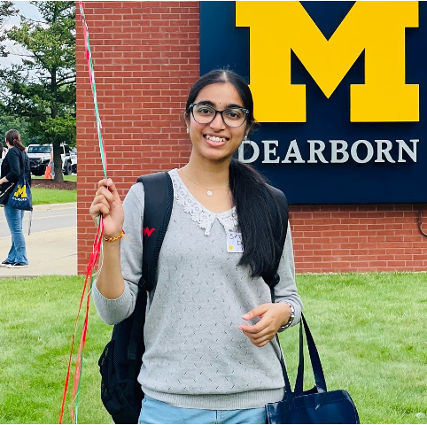
PROJECT MEMBERS

Slide 3
PROJECT MEMBERS
GOKULNATH ANAND
SAI SANJITH SIVAPURAM
GBENGA LADAPO
SRI HARITHA DEEVI

Slide 4

AGENDA
PROJECT GOAL
DATASET
METHODOLOGY
RESULTS
CONTRIBUTION AND RESPONSIBILITIES
REFERENCES

Slide 5
AGENDA
PROJECT GOAL
DATASET
METHODOLOGY
CONCLUSION
RELATED WORK
CONTRIBUTION AND RESPONSIBILITIES
REFERENCES

Slide 6
AGENDA
PROJECT GOAL
DATASET
METHODOLOGY
CONCLUSION
RELATED WORK
CONTRIBUTION AND RESPONSIBILITIES
REFERENCES

Slide 7
AGENDA
PROJECT GOAL
DATASET
METHODOLOGY
CONCLUSION
RELATED WORK
CONTRIBUTION AND RESPONSIBILITIES
REFERENCES

Slide 8
AGENDA
PROJECT GOAL
DATASET
METHODOLOGY
RESULTS
RELATED WORK
CONTRIBUTION AND RESPONSIBILITIES
REFERENCES

Slide 9
AGENDA
PROJECT GOAL
DATASET
METHODOLOGY
RESULTS
RELATED WORK
CONTRIBUTION AND RESPONSIBILITIES
REFERENCES

Slide 10
AGENDA
PROJECT GOAL
DATASET
METHODOLOGY
RESULTS
RELATED WORK
REFERENCES

Slide 11
PROJECT GOAL

Slide 12

PROJECT GOAL
This project aims to explore rule-based and traditional machine learning techniques for question-answering tasks, using the Stanford Question Answering Dataset (SQuAD).
Unlike common deep learning approaches, this study focuses on the application of conventional NLP methods and machine learning models such as Random Forests, Gradient Boosting Machines, and SVMs.
The goal is to evaluate the efficacy of these methods in comparison to more resource-intensive deep learning solutions, examining their potential advantages and limitations in the context of question answering.

Slide 13
DATASET

Slide 14

DATASET
The dataset used is the SQuAD 1.1, chosen for its straightforward question-answer format and the absence of unanswerable questions. It comprises over 100,000 question-answer pairs from more than 500 Wikipedia articles. The dataset is a standard for evaluating reading comprehension in NLP.
The following are the features in the dataset:
Title
Context
Question
Answer
Answer Start

Slide 15
METHODOLOGY

Slide 16
METHODOLOGY
Data Acquisition
&
Transformation
Exploratory Data Analysis (EDA)
Data Cleaning
Data Normalization
Data
Pre-processing
Feature
Engineering
Model Training
&
Testing
Answer
Extraction
Function

Slide 17
METHODOLOGY
Exploratory Data Analysis (EDA)
Data Acquisition
&
Transformation
Data Cleaning
Data Normalization
Data
Pre-processing
Feature
Engineering
Model Training
&
Testing
Answer
Extraction
Function

Slide 18
METHODOLOGY
Data Acquisition
&
Transformation
Exploratory Data Analysis (EDA)
Data Cleaning
Data Normalization
Data
Pre-processing
Feature
Engineering
Model Training
&
Testing
Answer
Extraction
Function

Slide 19
METHODOLOGY
Data Acquisition
&
Transformation
Exploratory Data Analysis (EDA)
Data Normalization
Data Cleaning
Data
Pre-processing
Feature
Engineering
Model Training
&
Testing
Answer
Extraction
Function

Slide 20
METHODOLOGY
Data Acquisition
&
Transformation
Exploratory Data Analysis (EDA)
Data Normalization
Data Cleaning
Feature
Engineering
Model Training
&
Testing
Answer
Extraction
Function
Data
Pre-processing

Slide 21

METHODOLOGY
Data Acquisition
&
Transformation
Exploratory Data Analysis (EDA)
Data Normalization
Data Cleaning
Model Training
&
Testing
Answer
Extraction
Function
Data
Pre-processing
Feature
Engineering
Notes:
And within Feature Engineering for text analysis, the transformation of words into numbers is a vital step, and that’s where TF-IDF comes into play. It stands for Term Frequency-Inverse Document Frequency. This technique converts text into a numerical statistic that reflects the importance of a word relative to a document and the entire corpus.
The beauty of TF-IDF is its ability to highlight the most relevant words that characterize a document. For instance, in a corpus where the word 'apple' frequently appears in a document about fruit but is rare in others, TF-IDF will assign it a high value in that particular document, signifying its importance.

Slide 22
METHODOLOGY
Data Acquisition
&
Transformation
Exploratory Data Analysis (EDA)
Data Normalization
Data Cleaning
Answer
Extraction
Function
Model Training
&
Testing
Data
Pre-processing
Feature
Engineering
Notes:
Moving on to our machine learning model, we employ a Support Vector Machine with a linear kernel. SVM is particularly adept at handling high-dimensional space, which is typical when dealing with text data. It works by finding the hyperplane that best divides a dataset into classes.
The training phase involves taking our TF-IDF vectors and teaching the SVM to classify whether a context contains an answer. We split our dataset into training and testing sets, ensuring that we can assess our model's performance objectively. We are looking for high scores in precision and recall, and ultimately, the F1-score, which balances the two.

Slide 23
METHODOLOGY
Data Acquisition
&
Transformation
Exploratory Data Analysis (EDA)
Data Normalization
Data Cleaning
Model Training
&
Testing
Answer
Extraction
Function
Data
Pre-processing
Feature
Engineering
Notes:
Finally, we have the answer extraction function. This is where we put our trained SVM to work. The function processes new contexts, breaks them into sentences, vectorizes these sentences, and uses our SVM to predict which sentences likely contain the answer.

Slide 24
RESULTS
Notes:
So now, I will be taking over from Gokul. On this slide, I will be walking you through the performance metrics of our model in comparison to a baseline established by Stanford University.

Slide 25
RESULTS
The F1 score produced by the baseline logistic regression model from Stanford was 51% whereas the F1 score produced by our model was 65%. This states that our model has a better performance in identifying the presence of an answer in the context as compared to identifying its absence
 | Precision | Recall | F1-score | Support
0 | 0.55 | 0.32 | 0.41 | 6036
1 | 0.71 | 0.86 | 0.78 | 11484
Accuracy |  |  | 0.68 | 17520
Macro avg | 0.63 | 0.59 | 0.59 | 17520
Weighted avg | 0.65 | 0.68 | 0.65 | 17520
Notes:
The baseline logistic regression model from Stanford achieved an F1 score of 51%. In contrast, our model, which employs traditional machine learning techniques, specifically Support Vector Machine(SVM) notably outperformed this baseline with an F1 score of 65%. This significant improvement highlights our model's enhanced capability in accurately identifying the presence of answers within a given context.
It's important to note that the F1 score is a balanced measure of a model's precision and recall, and a higher score indicates a more effective model. Our model's higher F1 score suggests it is not only better at recognizing when answers are present but also more accurately discerns when they are not, compared to the Stanford baseline.
Now, let's dive into the specifics of our model's performance as detailed in the table.
For Class 0, which represents cases where the answer is not present, our model achieved a precision of 55% and a recall of 32%, culminating in an F1 score of 41%. While these figures indicate room for improvement in recognizing the absence of answers, it's Class 1 where our model truly excels.
In Class 1, identifying the presence of answers, our model demonstrated a precision of 71% and an impressive recall of 86%. This leads to a robust F1 score of 78% for Class 1, significantly outperforming the baseline in accurately identifying contexts containing the correct answers.
The overall accuracy of our model stands at 68%, with a weighted average F1-score of 65%. The balanced nature of these metrics across both classes highlights the model's effectiveness and reliability in diverse scenarios within the question-answering domain.

Slide 26
RELATED WORKS
Notes:
Moving on to the next slide, we will explore the 'Related Works' in the realm of question-answering systems

Slide 27
RELATED WORKS
The landscape of question-answering (QA) systems has been profoundly influenced by various approaches spanning from traditional algorithms to advanced deep learning techniques. Our study situates itself amidst this diverse array of methodologies.
TRADITIONAL ML MODELS
TRADITIONAL ML MODELS
RULE BASED SYSTEMS
HYBRID APPROACHES
ENSEMBLE METHODS
SEMANTIC PARSING
Notes:
This field has seen a rich variety of methodologies, each contributing uniquely to how we approach the task of automated question-answering.
At the core, we have traditional machine learning models, which have laid the groundwork for pattern recognition and natural language processing. These models, while not as complex as their successors, have been pivotal in the early stages of QA development.

Slide 28
RELATED WORKS
The landscape of question-answering (QA) systems has been profoundly influenced by various approaches spanning from traditional algorithms to advanced deep learning techniques. Our study situates itself amidst this diverse array of methodologies.
RULE BASED SYSTEMS
TRADITIONAL ML MODELS
DEEP LEARNING
HYBRID APPROACHES
ENSEMBLE METHODS
SEMANTIC PARSING
Notes:
Branching out from these, we see the advent of deep learning techniques, which have significantly advanced the field. Deep learning's ability to process and learn from large volumes of data has led to remarkable improvements in the accuracy and nuance of QA systems.

Slide 29
RELATED WORKS
The landscape of question-answering (QA) systems has been profoundly influenced by various approaches spanning from traditional algorithms to advanced deep learning techniques. Our study situates itself amidst this diverse array of methodologies.
DEEP LEARNING
TRADITIONAL ML MODELS
HYBRID APPROACHES
HYBRID APPROACHES
ENSEMBLE METHODS
SEMANTIC PARSING
Notes:
However, the complexity of language and the subtlety of human inquiry necessitate diverse approaches. This is where hybrid approaches come into play, blending the structured reasoning of traditional models with the adaptive learning capabilities of neural networks.

Slide 30
RELATED WORKS
The landscape of question-answering (QA) systems has been profoundly influenced by various approaches spanning from traditional algorithms to advanced deep learning techniques. Our study situates itself amidst this diverse array of methodologies.
DEEP LEARNING
TRADITIONAL ML MODELS
RULE BASED SYSTEMS
ENSEMBLE METHODS
ENSEMBLE METHODS
SEMANTIC PARSING
Notes:
Moreover, ensemble methods further enhance performance by combining the predictions of multiple models to produce a more accurate output. By leveraging the strengths of various approaches, ensemble methods often achieve superior results.

Slide 31
RELATED WORKS
The landscape of question-answering (QA) systems has been profoundly influenced by various approaches spanning from traditional algorithms to advanced deep learning techniques. Our study situates itself amidst this diverse array of methodologies.
DEEP LEARNING
TRADITIONAL ML MODELS
RULE BASED SYSTEMS
SEMANTIC PARSING
ENSEMBLE METHODS
RULE BASED SYSTEMS
Notes:
Lastly, we must not overlook the contribution of rule-based systems and semantic parsing. Rule-based systems, with their logical constructs and semantic parsing with their focus on understanding meaning, have been fundamental in interpreting and answering complex questions.

Slide 32
RELATED WORKS
The landscape of question-answering (QA) systems has been profoundly influenced by various approaches spanning from traditional algorithms to advanced deep learning techniques. Our study situates itself amidst this diverse array of methodologies.
DEEP LEARNING
TRADITIONAL ML MODELS
RULE BASED SYSTEMS
HYBRID APPROACHES
RULE BASED SYSTEMS
SEMANTIC PARSING
Notes:
Lastly, we must not overlook the contribution of rule-based systems and semantic parsing. Rule-based systems, with their logical constructs and semantic parsing with their focus on understanding meaning, have been fundamental in interpreting and answering complex questions.
Together, these methodologies form a comprehensive ecosystem, each with its strengths and challenges, contributing to the continuous evolution of question-answering systems. Our study situates itself within this spectrum, aiming to harness and build upon these diverse techniques to advance the field.
In conclusion, our exploration into the domain of question-answering systems has revealed the strengths and opportunities of traditional machine learning techniques. We hope that our work not only contributes to the ongoing dialogue in NLP research but also paves the way for future innovations that balance computational efficiency with the nuanced understanding of human language.
And here are our references.

Slide 33
REFERENCES

Slide 34
REFERENCES
Devlin, J., Chang, M. W., Lee, K., & Toutanova, K. (2018). BERT: Pre-training of Deep Bidirectional Transformers for Language Understanding. arXiv:1810.04805.
Rajpurkar, P., Zhang, J., Lopyrev, K., & Liang, P. (2016). SQuAD: 100,000+ Questions for Machine Comprehension of Text. arXiv:1606.05250.
Joachims, T. (1998). Text categorization with Support Vector Machines: Learning with many relevant features. European Conference on Machine Learning.
Radford, A., Narasimhan, K., Salimans, T., & Sutskever, I. (2018). Improving Language Understanding by Generative Pre-Training. URL https://s3-us-west-2.amazonaws.com/openai-assets/research-covers/language-unsupervised/language_understanding_paper.pdf.
Peters, M. E., Neumann, M., Iyyer, M., Gardner, M., Clark, C., Lee, K., & Zettlemoyer, L. (2018). Deep contextualized word representations. arXiv:1802.05365.
Moschitti, A., Quarteroni, S., Basili, R., & Manandhar, S. (2007). Exploiting Syntactic and Shallow Semantic Kernels for Question Answer Classification. ACL.
Cui, Y., Chen, Z., Wei, S., Wang, S., Liu, T., & Hu, G. (2017). Attention-over-Attention Neural Networks for Reading Comprehension. ACL.
Voorhees, E. M., & Tice, D. M. (2000). Building a question answering test collection. Proceedings of the 23rd annual international ACM SIGIR conference on Research and development in information retrieval.
Freund, Y., Iyer, R., Schapire, R. E., & Singer, Y. (2003). An Efficient Boosting Algorithm for Combining Preferences. The Journal of Machine Learning Research, 4.
Breiman, L. (2001). Random Forests. Machine Learning, 45(1), 5-32.
Salton, G., & McGill, M. J. (1986). Introduction to Modern Information Retrieval. McGraw-Hill
Notes:
Thank you for listening. Goodbye!

Slide 35
THANK YOU
Notes:
Thank you for listening. Goodbye!

